Slide 1
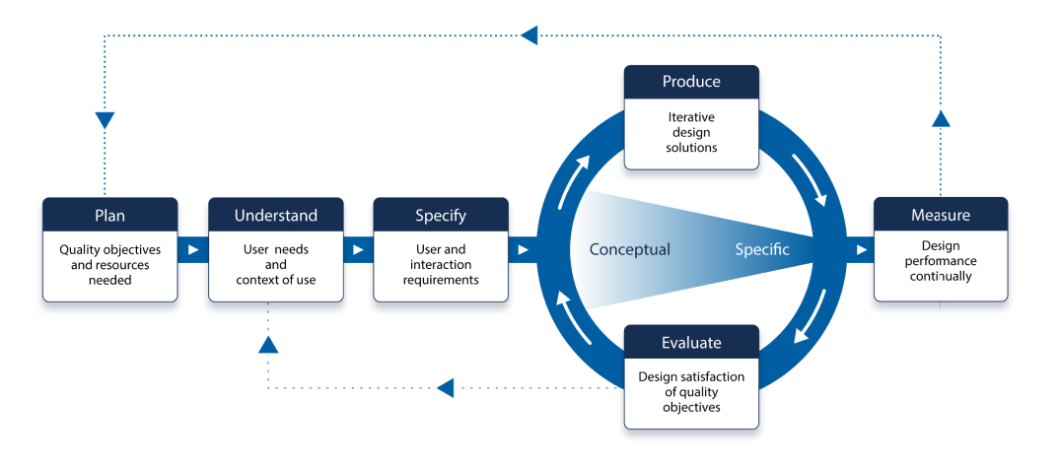
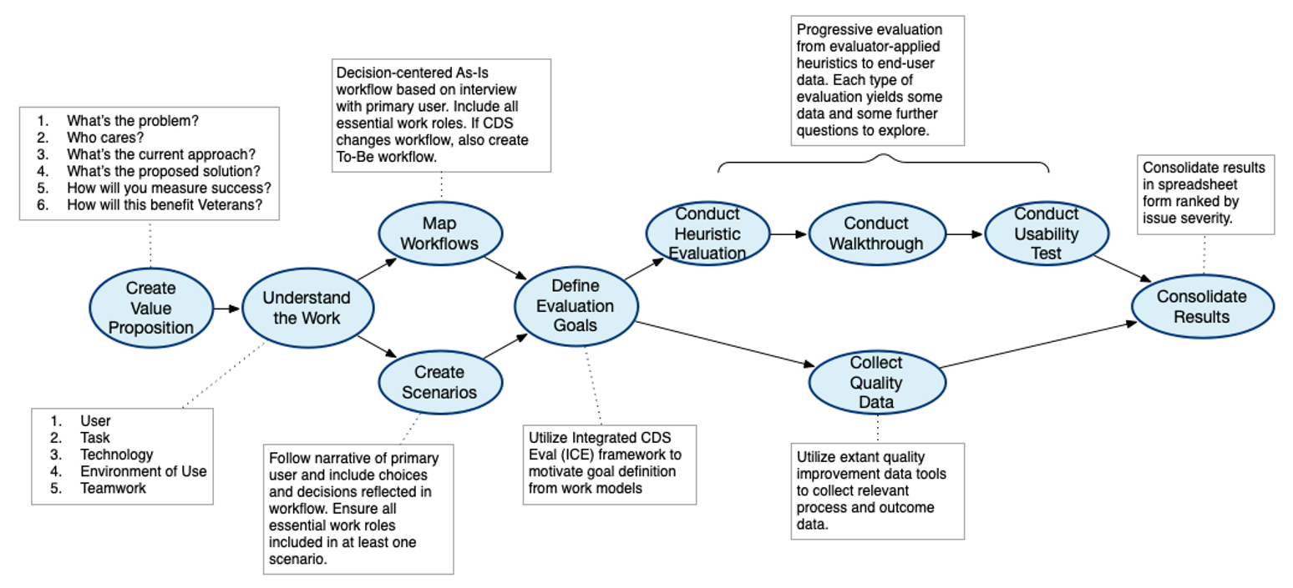
Plan
Understand
Specify
Produce/Evaluate
Measure

Slide 2
Objectives
Define the problem
Define scope of project
Define measures of success (business and usability quality objectives)
Objectives
Understand the work (context of use)
User
Task
Technology
Workflow
Use Environment
Teamwork (Interactions with other users and other systems)
Objectives
Specify desired state with stakeholder agreement
Objectives
Evaluate usability of existing design solution
Identify gap between current and desired state of system
Objectives
Define scope of DESIGN project
Objectives
Fill knowledge gaps (if needed)
Objectives
Specify user and interaction requirements
Objectives
Begin iterative design cycle
Objectives
Monitor performance of new design in the field
Interview Stakeholders
User Interview
Heuristic Evaluation
Analyze extant quality data
Usability Walkthrough
Activities
Map Workflow
Specify use-related quality requirements
Write a Problem Statement
Create Use Scenarios
Gap Analysis
Create a Value Proposition
ISO Phase | Objectives | Activities | Content types and artifacts
Plan | Define the problem Define the scope of the project Define measures of success | Interview stakeholders / negotiate needs Analyze extant quality data Write a problem statement Create a value proposition | UXG Method page: Stakeholder Interview UXG Method page: Problem Statement UXG Tool: Planning Meeting Guide/Template Template/Examples: ‘Value Proposition’
Understand | Users Task Technology Workflow Environment Teamwork | Interview end users Map workflow Create use scenarios | UXG Method page: User Interview UXG Method page: Clinical Workflow Modeling UXG Tutorial: Workflow Modeling UXG Tool: User Interview Guide/Template
Specify | Identify desired state and link to quality objectives (i.e., measures of success) | Specify use-related quality requirements
Understand | Evaluate usability of existing design Identify gap between current and desired state of system | Heuristic evaluation Usability walkthrough Gap analysis | UXG Method page: Heuristic Evaluation UXG Tool: Guided templates for Heuristic Evaluation UXG Design Examples & Guidelines: Common Usability Issues UXG Method page: Usability Walkthrough UXG Method page: Gap Analysis

